Slide 1
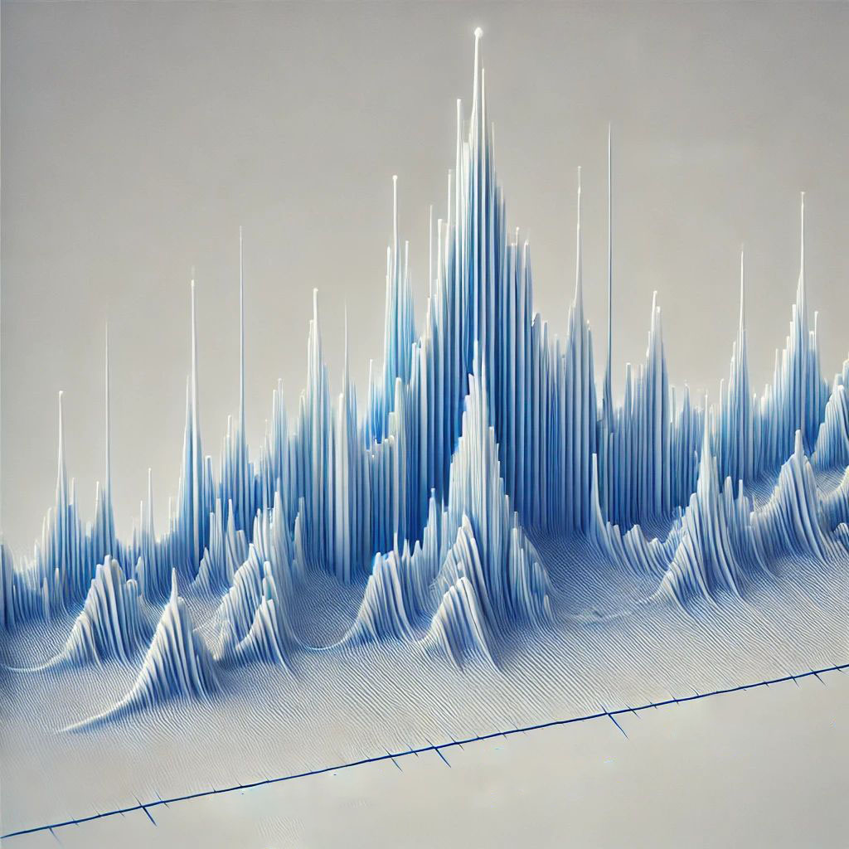
Rietveld Refinement Method
ACERS workshop on Tools for Visualizing and Understanding the Structure of Crystalline Ceramics
Taylor Sparks
Professor of Materials Science & Engineering, University of Utah

Slide 2
Overview
What is it and how does it work?
Quantitative analysis of multiple phases mixture
Amorphous content
Atomic position & site occupancy
Thermal displacement parameters
Preferred orientation
Crystallite size/strain

Slide 3

What is Rietveld refinement?
Hugo Rietveld (1969)
Quantitative refinement tool
Calculated pattern vs measured pattern
Variable model parameters
Least-squares refinement
Account for errors during measurement (shift, zero)
Different from LeBail or Pawley (Profile) fitting
Ab initio crystal structure determination
http://www.ccp14.ac.uk/poster-talks/rietveld-csiro-axaa-99/rietveld/index.htm

Slide 4
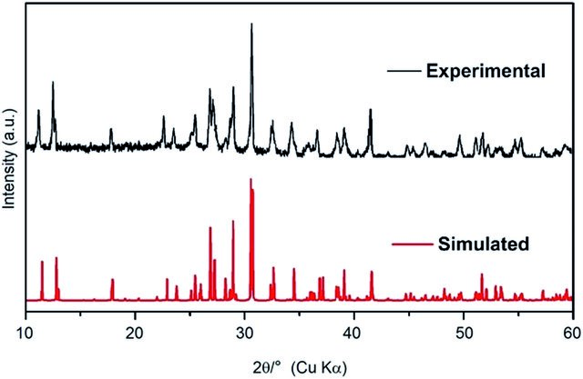
We can simulate patterns pretty well!

Slide 5
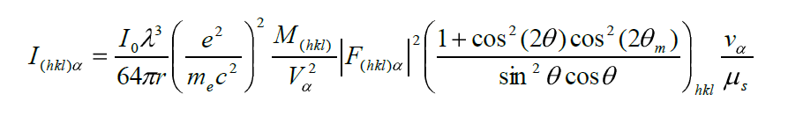
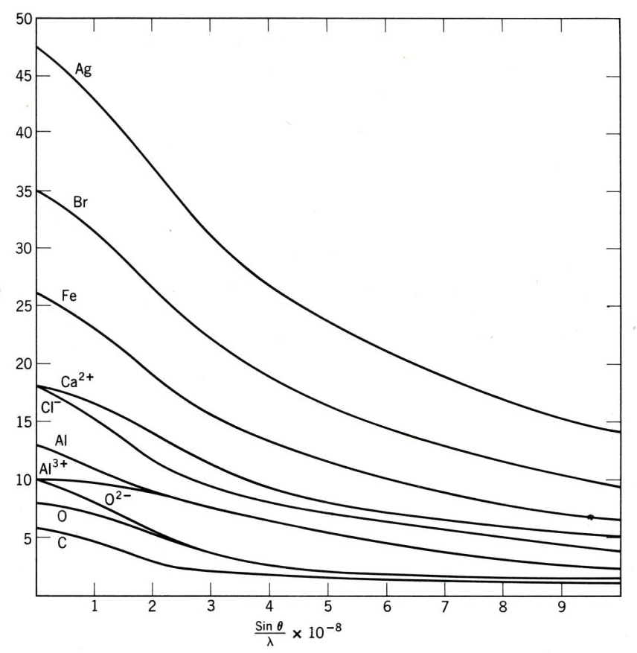


Intensity of a diffracted peak depends on many parameters!
James R. Connolly, for EPS400-001, Introduction to X-Ray Powder Diffraction, Spring 2010
Notes:
I= Intensity of reflection of hkl in phase
I_0= incident beam intensity
r = distance from specimen to detector
lambda= X-ray wavelength
(e^2/mc^2)^2= square of classical electron radius
s = linear absorption coefficient of the specimen
v = volume fraction of phase
Mhkl = multiplicity of reflection hkl of phase
0 = Lorentz-polarization (and monochromator) correction (next to last term to right)
v = volume of the unit cell of phase
2 m = diffraction angle of the monochromator
F(hkl) = structure factor for reflection hkl of phase (i.e., the vector sum of scattering intensities of all atoms contributing to that reflection

Slide 6
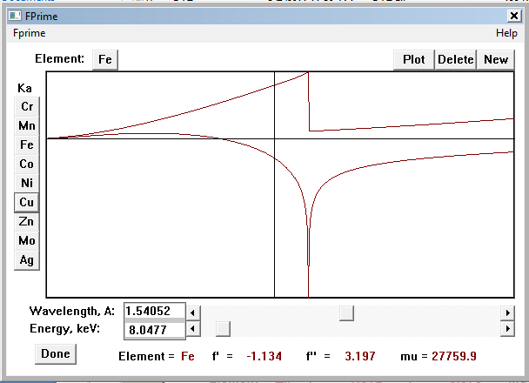
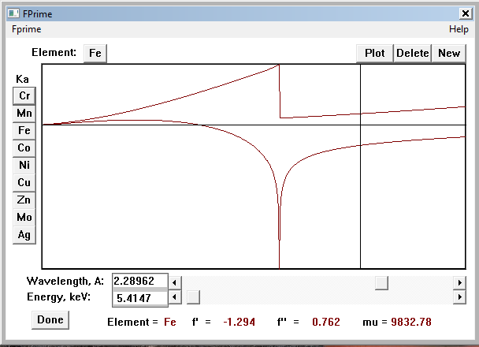
Anomalous Scattering Factors f’ & f” depends on radiation choice

Slide 7
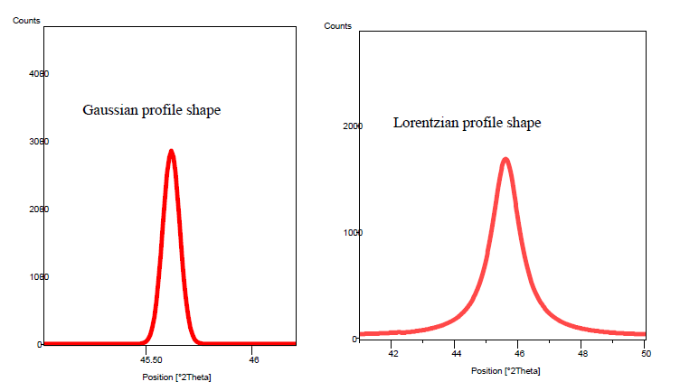

Different instruments yield different peak shape
prism.mit.edu/xray/Rietveld_XRDSimulation.pdf

Slide 8
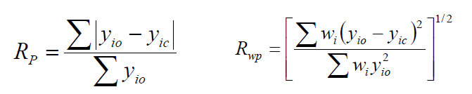
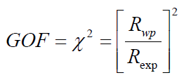
Quality of the Fit
R_{p} is the difference between the observed and the calculated value
R_{wp} weights the residual so the higher intensity peaks are more important than low intensity ones
R_{p} or R_{wp} should be < 10% or χ² < 4 for a good fit
prism.mit.edu/xray/RietveldGOF.pdf

Slide 9
Multiple cycles required to find the true global minimum in error
R_{wp}
False minimum
Least-squares cycles
True minimum – “global” minimum
“A Rietveld refinement is never finished, only abandoned” - P.W. Stephens
www.cins.ca/.../APDW08%20Rietveld%20Refinement%20with%20GSAS.ppt

Slide 10
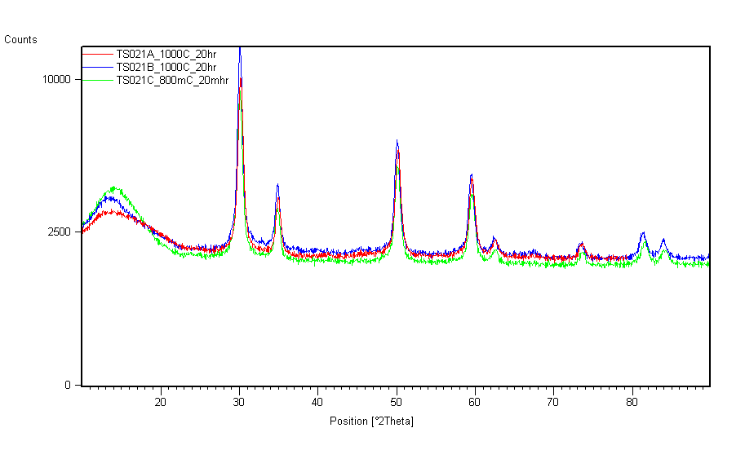
Quantitative Analysis of Multiple Phases Mixture

Slide 11
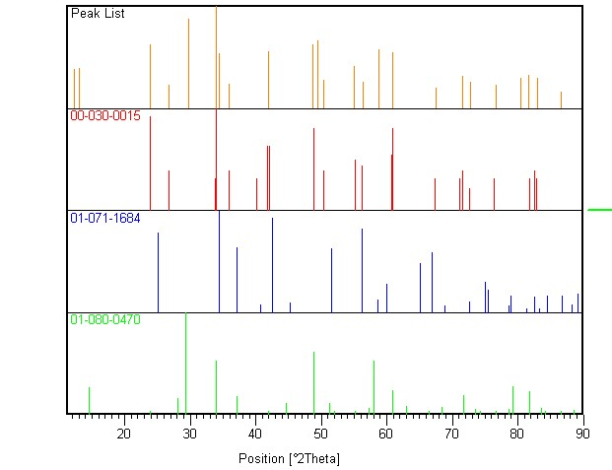
Quantitative Analysis of Multiple Phases Mixture

Slide 12
Weight Fraction: “SMZ” Method
S is phase fraction, proportional to number of unit cells measured
M is the molecular weight
Z is the number of formula units per unit cell
SMZ is proportional to the concentration

Slide 13
How Good is the Quantitive Analysis?
James Kaduk, ICDD, Rietveld Refinement Workshop Oct 2010

Slide 14
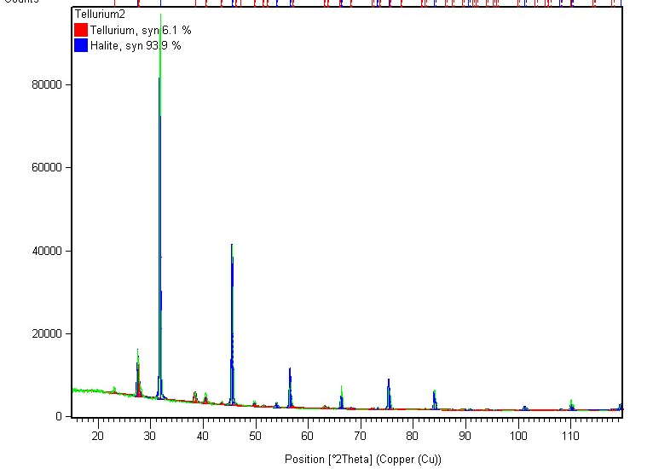
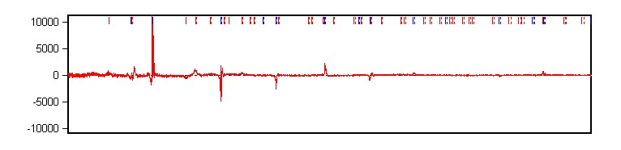
Te Fraction in Seawater Medium
93.9% NaCl
6.1% Te
R_{wp} = 6.9%
Errors: absorption (transparency), sample volume (more powder)

Slide 15
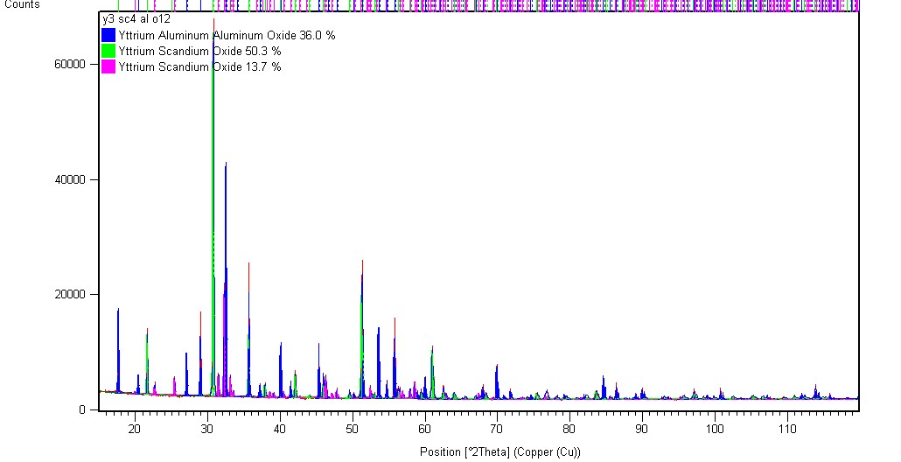
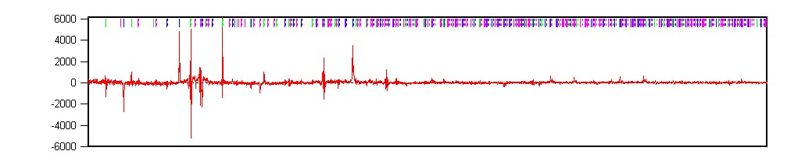
Y₃Sc₄AlO₁₂ Intended Composition
36% YAG (Ia-3d)
50.3% YScO₃ (Ia-3)
13.7% YScO₃ (Pnma)
R_{wp} = 5.3%

Slide 16
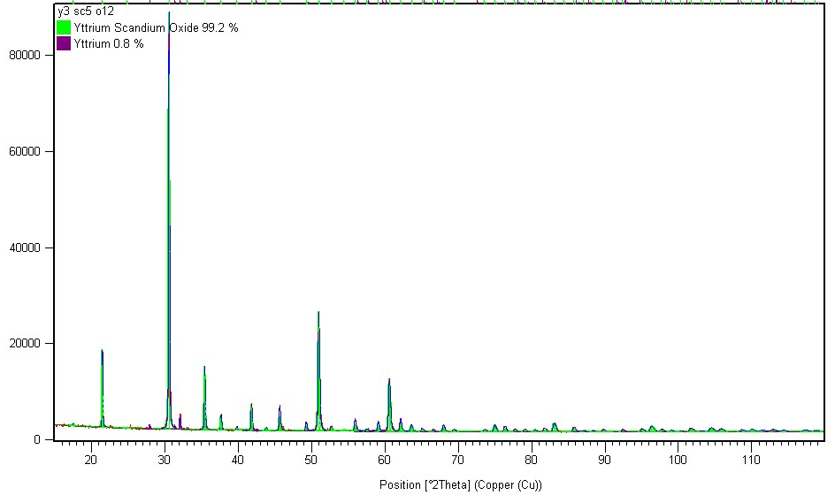
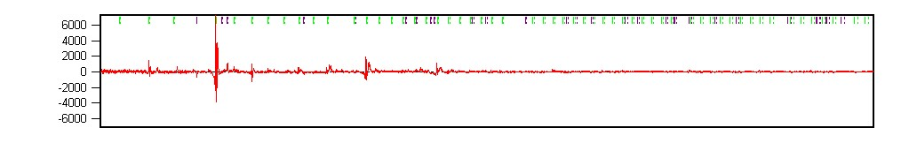
Y₃Sc₅O₁₂ Intended Composition
99.2% Y_{3/4}Sc_{5/4}O₃ (Ia-3)
0.8% Y(P63/mmc)
R_{wp} = 4.7%

Slide 17
Debye Equation for Amorphous Materials
Possible to determine percent amorphous material if standard is added in known amount.
amplitude
vibration
distance
Need radial distribution function to determine bond distances for analysis

Slide 18
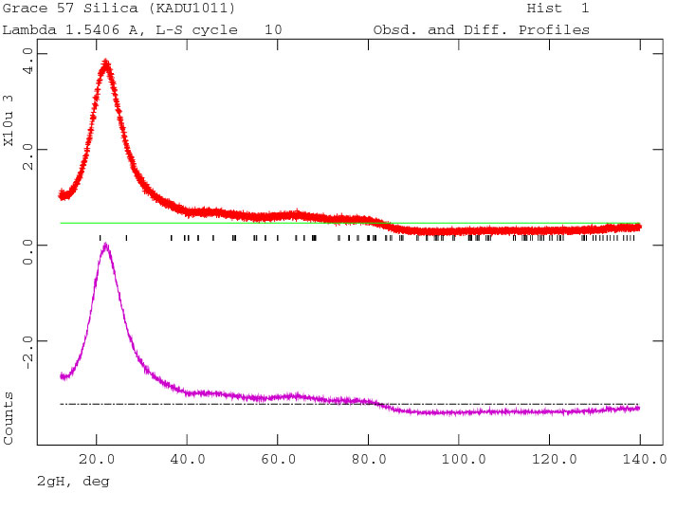
Diffuse Scattering
James Kaduk, ICDD, Rietveld Refinement Workshop Oct 2010

Slide 19
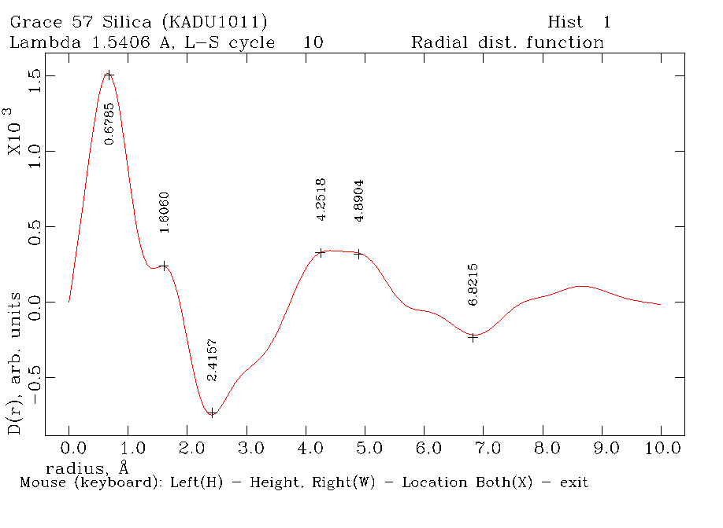
Diffuse Scattering
James Kaduk, ICDD, Rietveld Refinement Workshop Oct 2010

Slide 20
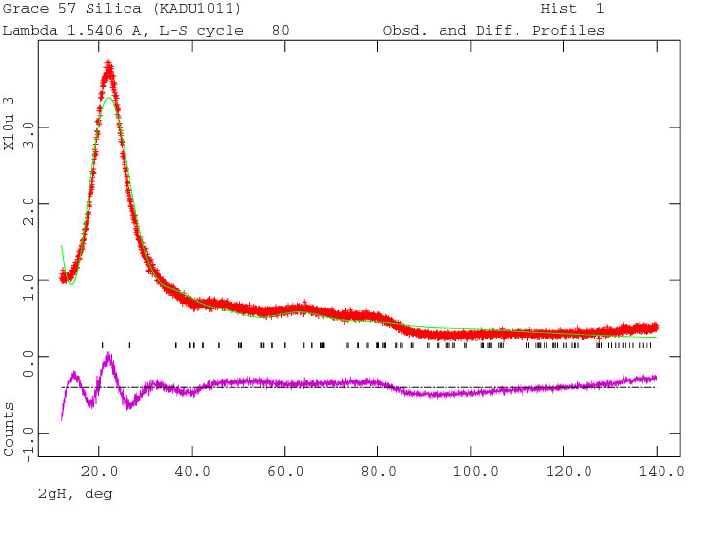
Diffuse Scattering
James Kaduk, ICDD, Rietveld Refinement Workshop Oct 2010

Slide 21
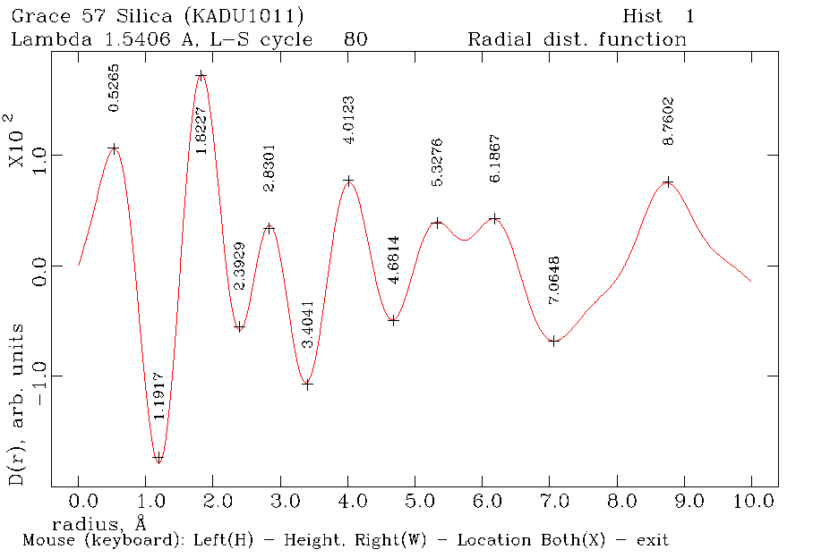
Diffuse Scattering
James Kaduk, ICDD, Rietveld Refinement Workshop Oct 2010

Slide 22
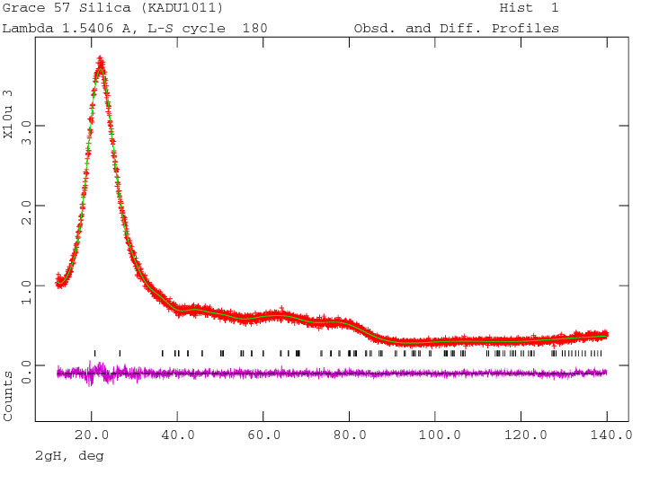
Diffuse Scattering
χ² = 1.112
James Kaduk, ICDD, Rietveld Refinement Workshop Oct 2010

Slide 23
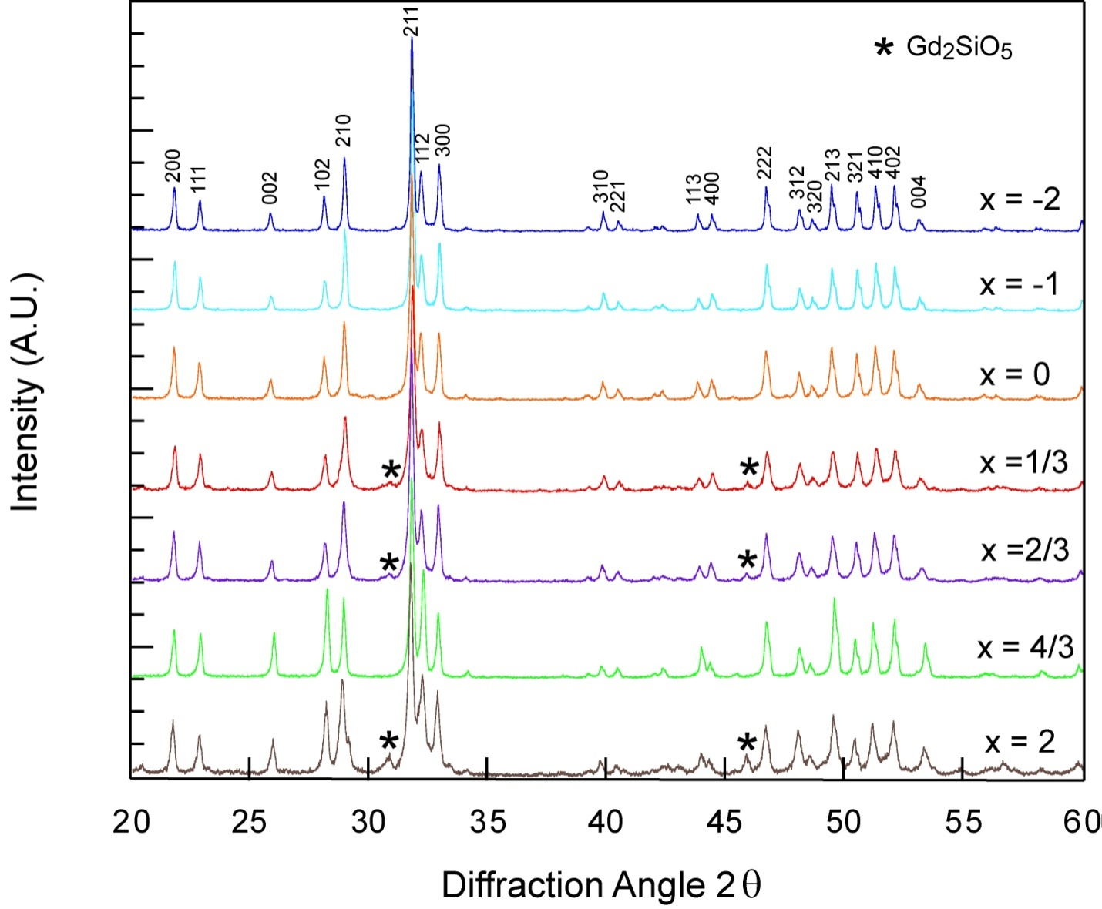
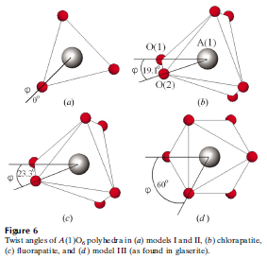
Atomic Position & Site Occupancy
Gd_{8+x}Ca_{2+y}(SiO₄)₆O_{2+3x/2+y} system
Anion/cation vacancies
Lab XRD insufficient
Impurity wt%?
Volume change?
Cation site preference?
Meta-prism twist?
White et al, Structural derivation and crystal chemistry of apatites, Acta Cryst. B, B59 1-16 2003

Slide 24
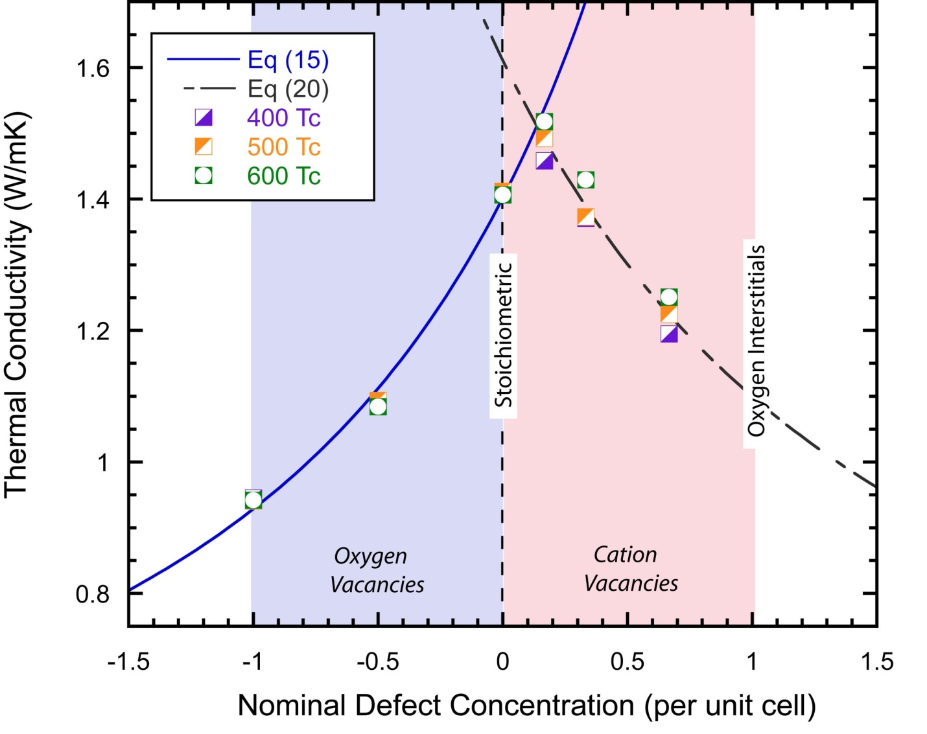
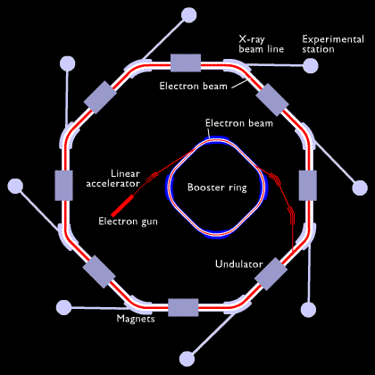
Atomic Position & Site Occupancy
Stoichiometric composition should have highest thermal conductivity
Phase separation?
Synchrotron diffraction
Improved signal to noise ratio
Improved resolution
Minimize anomalous scattering
http://www.odec.ca/projects/2005/shar5a0/public_html/mainpage.htm

Slide 25
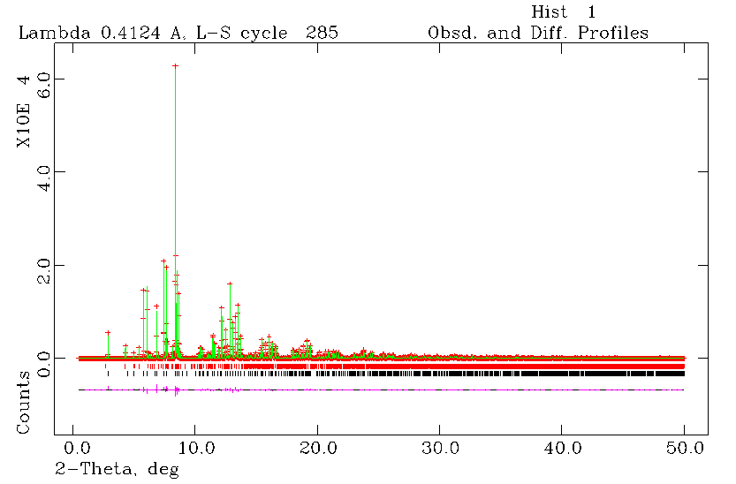
Atomic Position & Site Occupancy
R_{wp} = 6.29%
85% Gd_{7.7}Ca_{2.3}(SiO₄)₆O₂
14% Gd₂SiO₅
Ca has ~5% on A1
Meta prism twist 23.6º
Initial composition Gd_{8.333}Ca_{1.5}(SiO₄)₆O₂

Slide 26
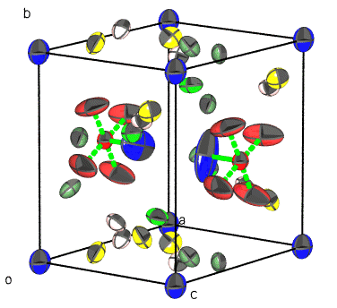
Thermal Displacement Parameters
Thermal vibrations quantitatively studied in Rietveld refinement
U_{iso} or U_{ij} for anisotropic vibration
Large U values could be due to rattling
Explanation of RE₂SrAl₂O₇ thermal conductivity?

Slide 27
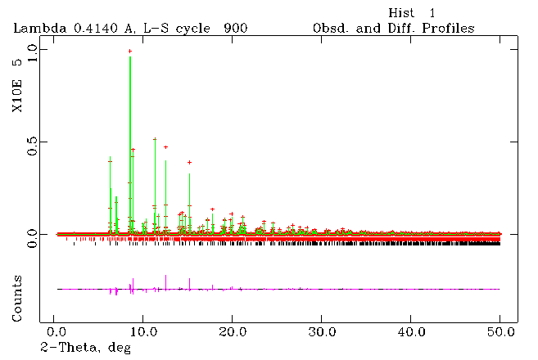
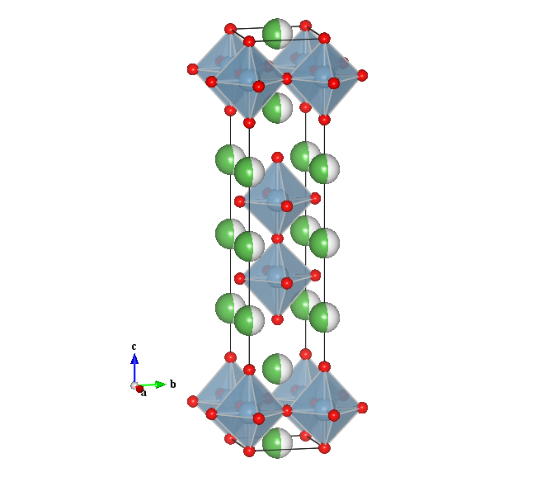
Thermal Displacement Parameters
A1 site
CN=12
P2 slab
A2 site CN=9
RS slab
Rocksalt layer
Double Perovskite layer
Rocksalt layer
Compostion | La₂SrAl₂O₇ | Nd₂SrAl₂O₇ | Sm₂SrAl₂O₇ | Eu₂SrAl₂O₇ | Gd₂SrAl₂O₇ | Dy₂SrAl₂O₇
Uiso A1 | 0.11(2) | 0.21(5) | 0.40(3) | 0.20(1) | 0.37(3) | 0.96(2)
A1 (P2) occupancy | .73 | .54 | .43 | .32 | .25 | .21
A2 (RS) occupancy | .27 | .46 | .56 | .67 | .72 | .79

Slide 28
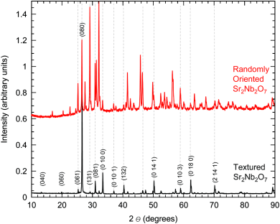
Preferential Orientation: Sr₂Nb₂O₇
Clearly textured to b-axis, but what is preferred orientation factor?

Slide 29
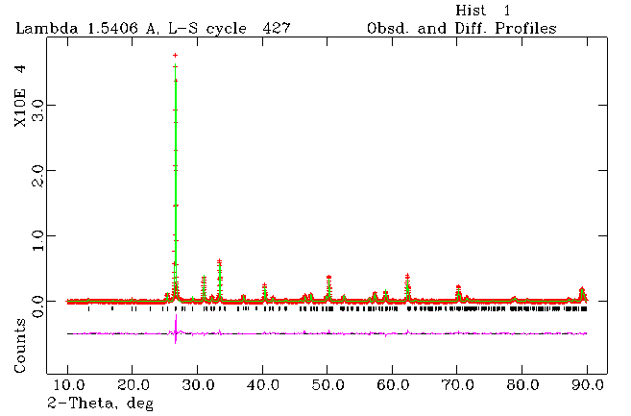
Preferential Orientation Sr₂Nb₂O₇
R_{wp} = 6.9%
Texture index = 5.52
Note: Actual compound had small amount of La³⁺ doped on Sr²⁺ site

Slide 30
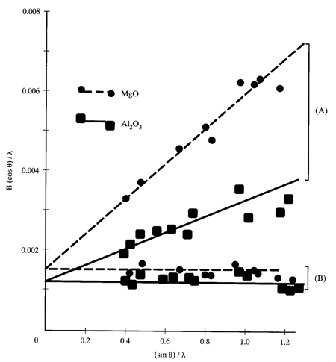
Size & Strain
First need to characterize the instrument shape parameters using a standard.
Then use U, V, W to obtain integral breadth for Scherrer’s & Stokes’ equation.
D_{v} = Kλ/{β cos θ}
ε = β/{4 tan θ}
{β_{obs} − β_{inst}}cos θ = λ/D_{v} + 4 ε{sin θ}
Williamson-Hall plot
Plot βcos(θ)/λ against 4 sin(θ)
Slope & intercept give size and strain

Slide 31
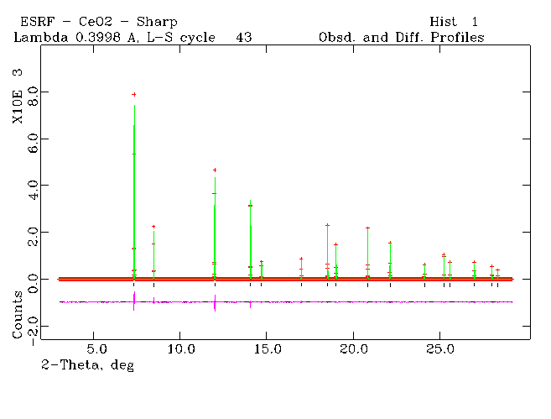
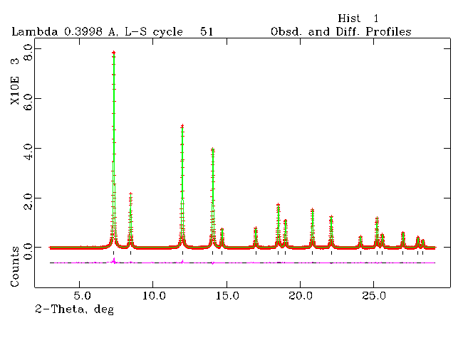
Size & Strain
CeO₂ before and after micronizing
Volume weighted domain size, D_{v}, of broadened CeO₂ is 226 Å and maximum strain, e is 0.011%

Slide 32
Summary
Rietveld refinement a valuable quantitative analysis tool for determining…
Crystal structure information
atomic positions, thermal displacement parameters, occupancy
Other information
Preferred orientation, size, strain, quantitative analysis (including amorphous material)

